Slide 1

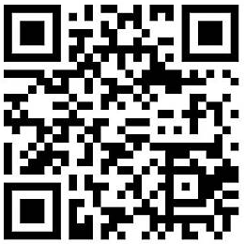
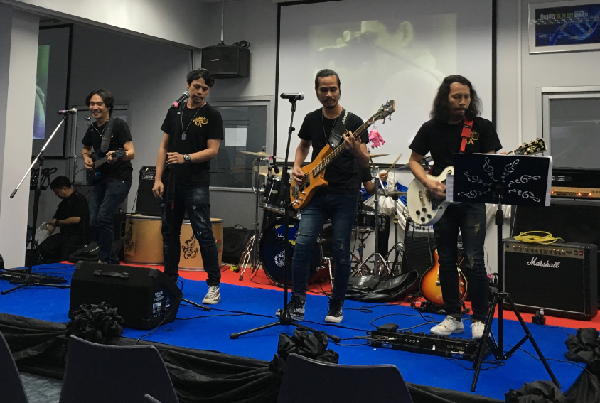
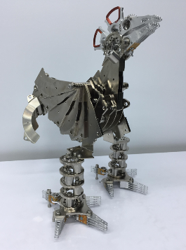
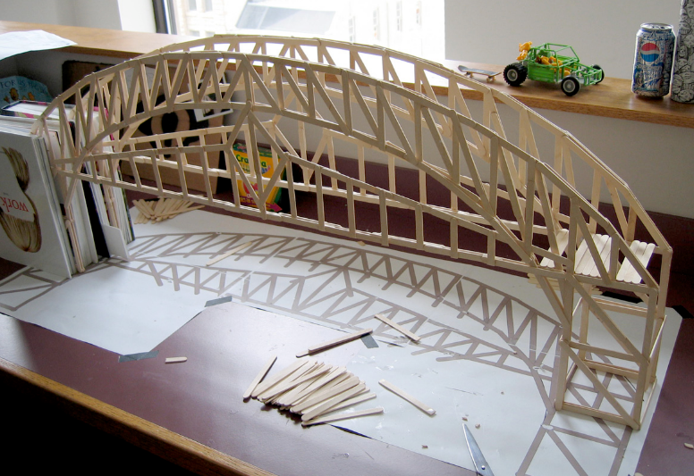
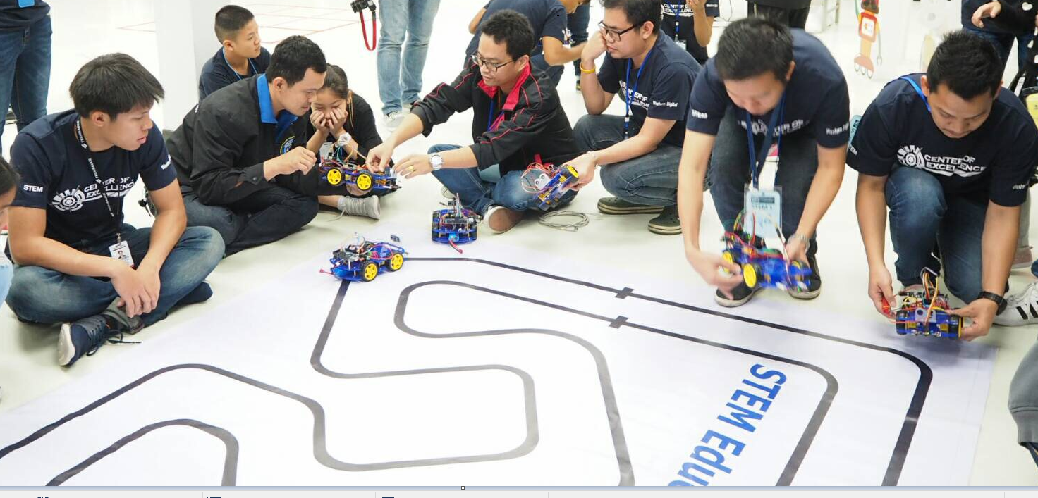
Exhibition Booth and Creative Activity
Innovation Bazaar : December 14 - 15, 2017
THEME: Power Of We. for Limitless Innovation
All WD Employees please kindly be invited to join Innovation Bazaar exhibition booth and creative activities from 4 different business areas: PRB, THO, TPE and BPI HDD, focusing on:
1. Advanced Process Technology
2. Quality
3. Operation Excellence
There are varieties of activities during the 2-day event:
Creativity and idea contest
Exhibition booth creative activities
Panel Discussion “ Thai Inventors”
Online activities submission
“FIN” Concert
Lucky draw
For more information, please contact our staff or visit our web site by just scanning QR code above.
(Online registration/ on line submission is available on the web site)

